Slide 1
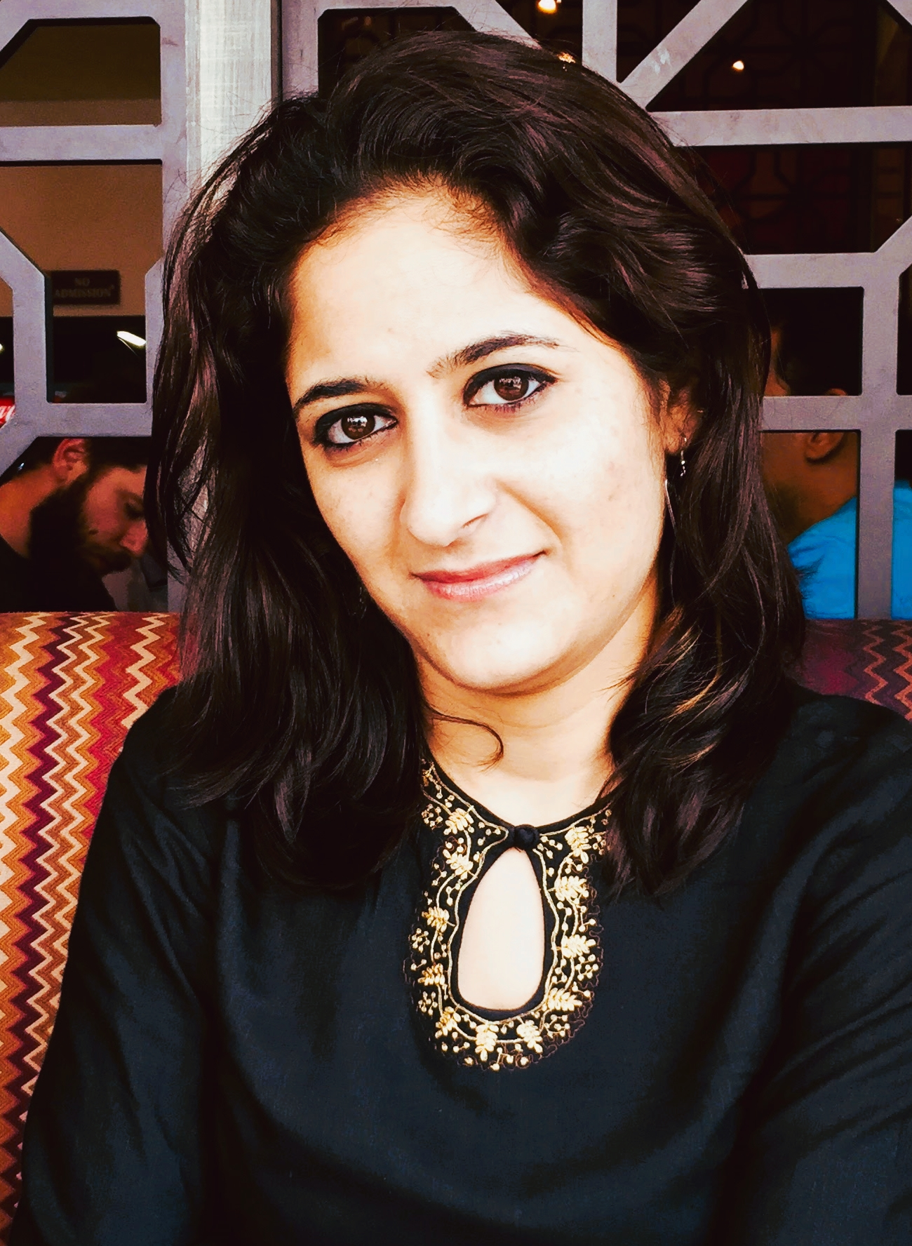
Maria Shah
, Performance Catalyst Coach, Facilitator
Helping Individuals achieve their True Potential
Maria is a Seasoned Learning & Development Professional, with around 10 years of Corporate Experience across a Plethora of National & International Banks – like HDFC, ICICI, Kotak Mahindra, Axis Bank
She has effortlessly pivoted into the virtual space as a Certified AB-NLP Coach and Practitioner, after completing her Successful Stint as a Corporate Trainer since past 5 years
She has been a part of Toastmasters, Canada Wing, wherein she shared space with International Level Speakers
She has Conducted Multiple Grooming Sessions and Personality Development Sessions for Managers, Graduates
Till Date, she has touched more than 3000 lives through her Communication Enhancement, Performance Management Programs and BFSI Product Trainings
She has been an Ardent believer of Personal Growth as a continuous Ongoing Endeavour
She is a firm believer in the fact that she Learns more than she teaches, every time she has an Interaction with her Participants
She believes that the only way to stay Motivated as a Person, is to view the achievements of People she Trains as her achievement

