Slide 1
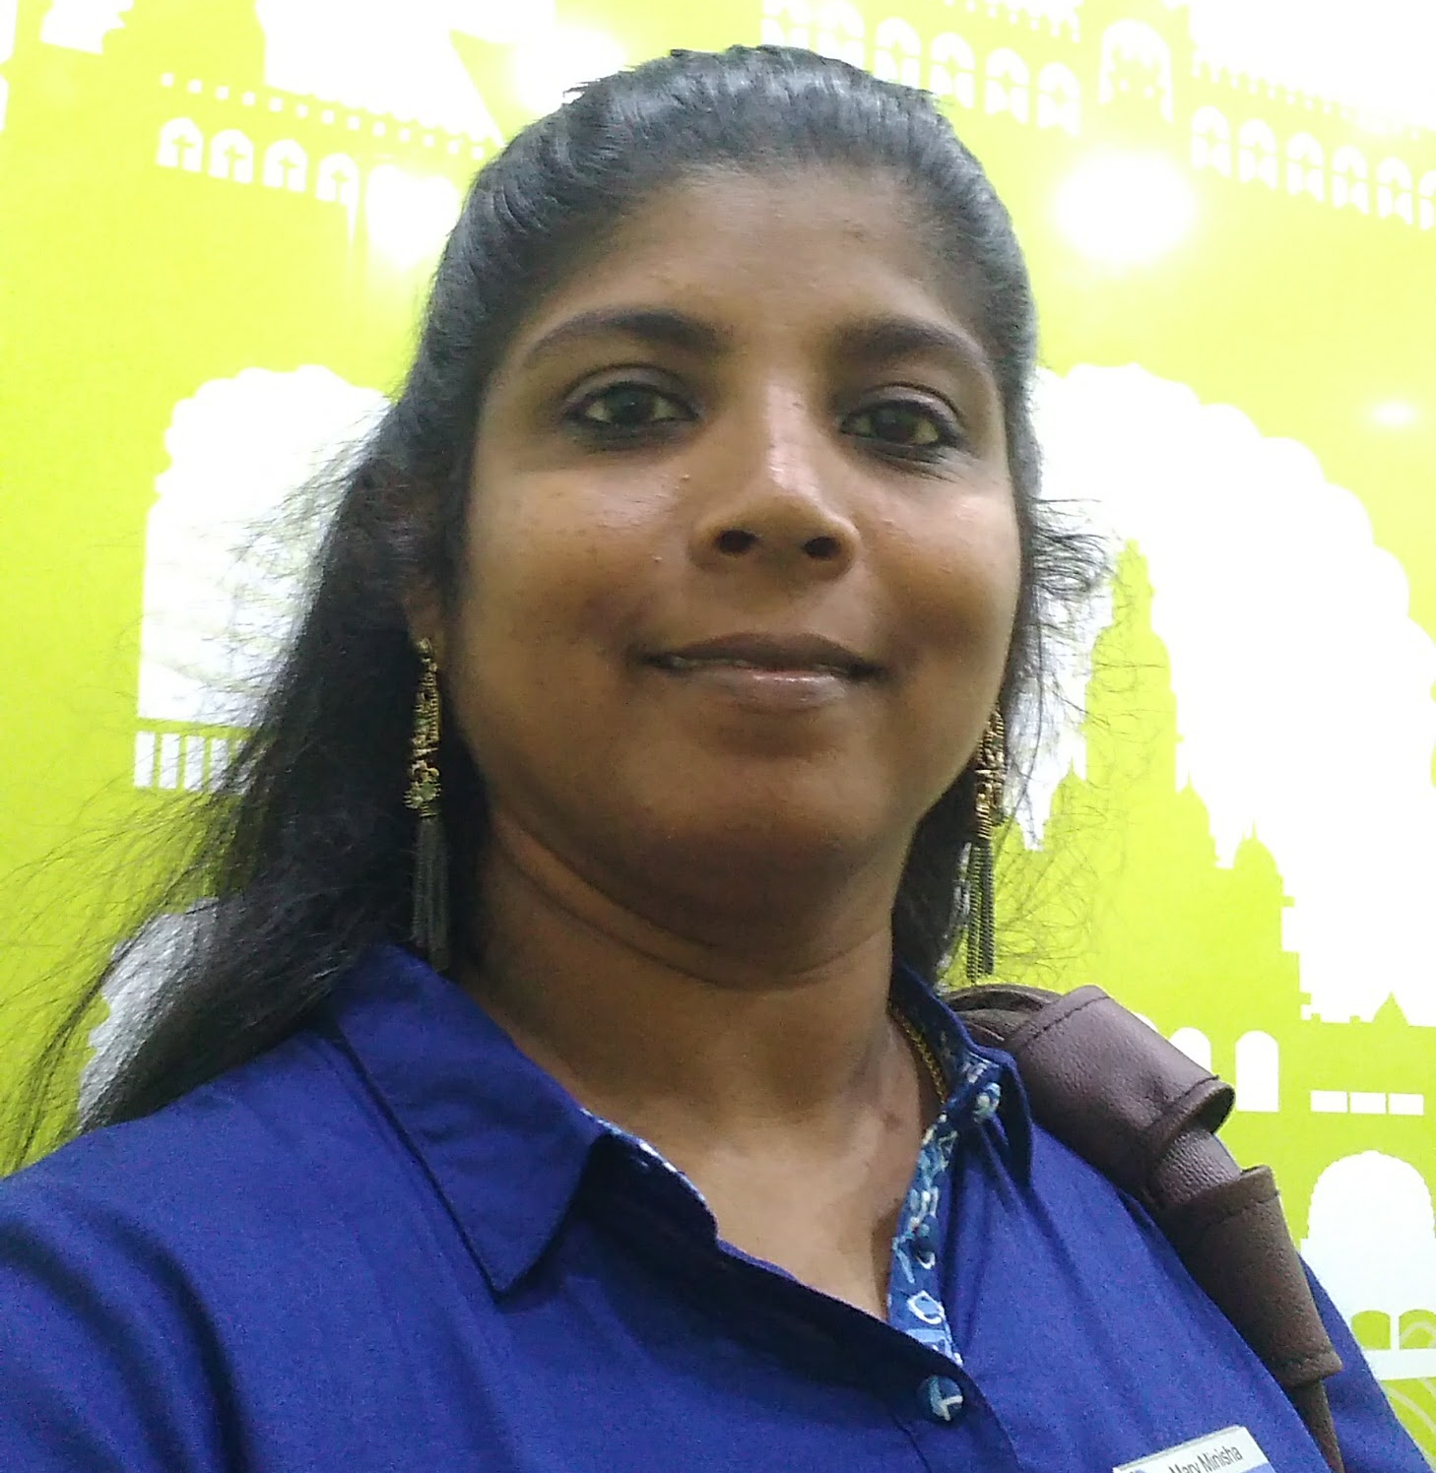
About the Facilitator:
Learning & Development Lead
Certified NLP Practitioner
Certified Life Coach
Minisha
Educational Qualification:
Master of Business Administration (Finance)
Contact Details:
Phone Number : 9945227711
Email Address : maryminisha@gmail.com

